Slide 1
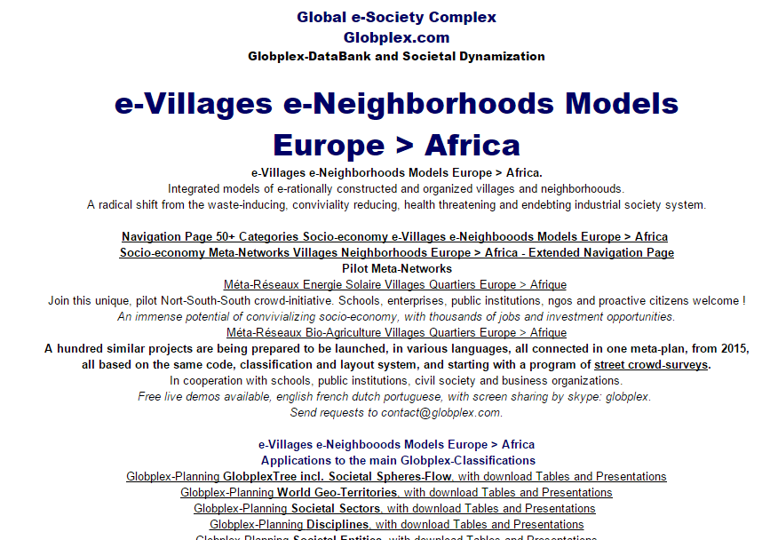
Europe > Africa Villages Neighborhoods Socio-economy Meta-Network
Putting in practice on local level, open data, open knowledge, collective awareness revelation, crowd-research,
open networking, collaborative economy, open democracy, etc.
Crowd-Construction Plan 2015-2020
Crowd-Research
Program
Convivial &
Sustainable
Socio-economy
Model. Topics include:
Replacing GDP
by Panergetic Index and Price System,
Interest-free Finance,
Debt-free Business
and Householding, Geo-Subsidiarity,
Transparency,
Citizens decisions
participation, etc.
www.globplex.com/ansea/
For Public Institutions, Enterprises, NGOs,
Schools, Media and Proactive Citizens,
in Europe, Africa, and all over the world.
A North-South concerted, radical shift towards
a waste-reducing,
conviviality inducing,
and debt-free
society system,
with lifelong learning, decent work, viable comfort
and overall good health
for all.
Synoptic
Navigation
Page
Network
Categories
Pilot
Network
Categories
Globplex-System ICT
Globplex DataBank System
Networks
per Country
and Region
example
Burkina Faso
Système
Energie Solaire
Series
Products Services
per
Country Region
example
Four Solaire
Domestique
Extended
Navigation
Page
Network
Categories
Version 17.02.2015
Global e-Society Complex
Crowd-Platform for Societal Re-engineering
globlex.com globplexholding.com
North-South Towns and Villages
Societal Twin System
© Globplex.net & Associates

